Slide 1
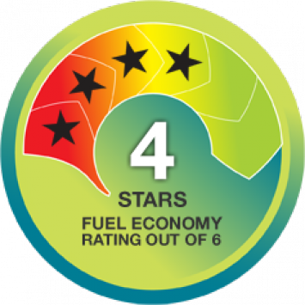
APEC Car Fuel Efficiency Labelling Review
APEC EGEE&C 43 Meeting – 9 to 11 April 2014

Slide 2
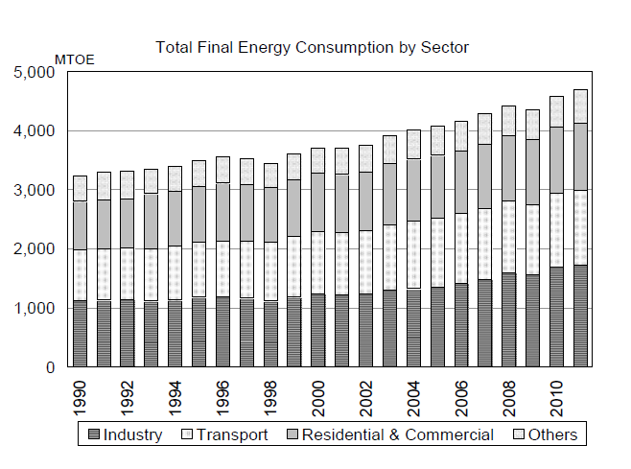
Background
Transport represents around 27% of all energy consumption across APEC
Significant energy and carbon saving potential
Several areas of intervention:
  Vehicle purchase
  Vehicle maintenance
  Driver behaviour
    How much they drive (PT, conservation)
    How they drive
  Low rolling resistance tyres

Slide 3
Background Continued
Large fuel efficiency gains potential
Most efficient in class is less than half of least efficient
Large amount of choice – many models under 6L/100km
  Small, large, medium, diesel, petrol, station wagon etc.

Slide 4
APEC Fit
2013 APEC leaders declaration:
  reiterates the importance of energy efficiency in transport and the commitment to the energy intensity reduction target of 45% by 2035
2011 APEC joint energy and transport ministers declaration
  We instruct the EWG and the Transportation Working Group (TPT-WG) to collaborate on joint activities …
2013 St Petersburg energy ministers declaration
  affirms that energy efficiency is one of the fastest, most environmentally sound, and cost effective ways to address climate change and energy security while stimulating economic growth

Slide 5
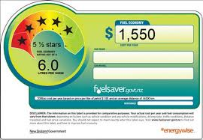
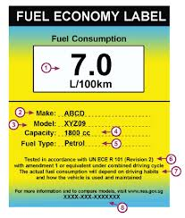
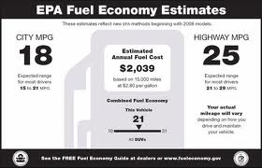
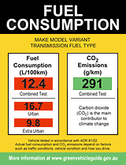
Vehicle Labelling
Intervention to address information barriers
Vehicle Fuel Efficiency Labelling
  used across several APEC economies
However many economies are yet to implement this type of scheme

Slide 6
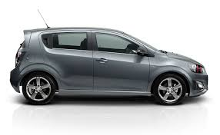

Holden Barina 7.3 L/100km
Mazda CX-5 6.4 L/100km

Slide 7
Project Objectives
Key Objective
Enable developing economies to implement fuel labelling schemes.
Project Objectives:
Analysis of existing labelling schemes across APEC.
Recommendations to harmonize APEC-wide fuel economy testing regimes including new vehicle technologies.
Assess the costs and benefits of harmonizing LV fuel economy information and policy.

Slide 8
Method
Identify existing schemes and develop analysis framework
Identify relevant test standards and their alignment with each other
Carry out assessment identifying strengths and weaknesses.
Identify transferable components useful to APEC economies
Generate recommendations for implementation
Carry out capacity building workshop

